Slide 1
The Security Built Into Colorado’s Elections
Caleb Thornton
Legal, Policy, and Rulemaking Manager
Colorado Secretary of State, Elections Division

Slide 2
CDOS Continuing Legal Education
Variety of topics - Title Board, Cybersecurity, Notary, and more!
Once per month through October
Visit online to sign-up at: https://www.coloradosos.gov/pubs/info_center/CLEseminars.html
Next session – July 11, “What is Title Board?”

Slide 3
Course Objectives
Why does it matter and how’d we get here?
Three areas of concern:
  List maintenance
  System testing
  Ballot integrity
Where do we go from here?

Slide 4
Why Does it Matter?
Survey conducted by CU Boulder and YouGov
Elections across the country will be conducted fairly and accurately
  75% of Democrats
  46% of Independents
  41% of Republicans
Elections in Colorado will be conducted fairly and accurately
  88% of Democrats
  63% of Independents
  54% of Republicans

Slide 5
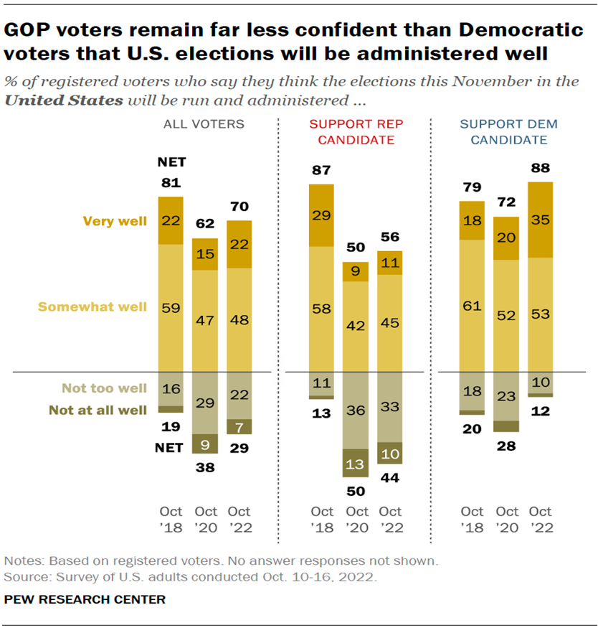
How Did We Get Here?

Slide 6
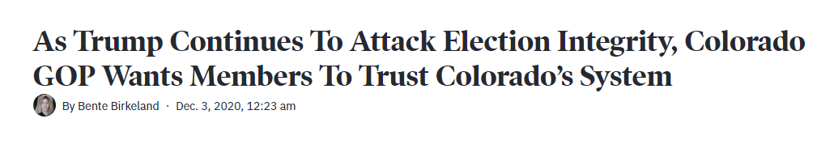
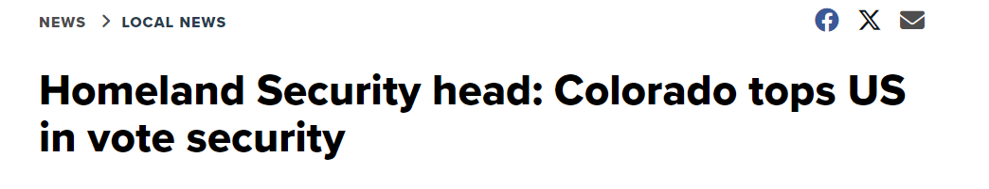
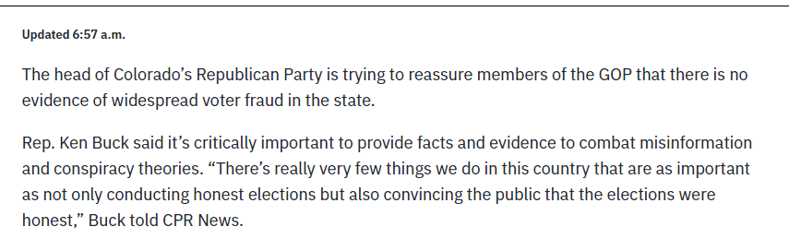
What Do Others Think?

Slide 7
Colorado Constitution
Article II, Section 5: “Freedom of elections. All elections shall be free and open; and no power, civil or military, shall at any time interfere to prevent the free exercise of the right of suffrage.”
Article VII, Section 11: “Purity of elections. The general assembly shall pass laws to secure the purity of elections, and guard against abuses of the elective franchise.”

Slide 8
HB 1303
Created many standards that we follow today
  Mail ballots
  Standardized list maintenance
  Vote centers
  Central counting
  Same-day voter registration

Slide 9
Federal Law
National Voter Registration Act (NVRA) of 1993
  Standardize list maintenance procedures
  “Motor voter”
Help America Vote Act (HAVA)
  Replacement of old voting systems (punch cards)
  Creation of Election Assistance Commission (EAC)
  Creation of voting system standards

Slide 10
List Maintenance
What is it?
  The process state and county election officials use to maintain accurate and up-to-date voter rolls.
Basic Terminology
  Active vs. Inactive vs. Cancelled

Slide 11
List Maintenance, Federal Law
NVRA
  Created a process by which states could cancel voters off voter roll
  Requires states to, “conduct a general program that makes a reasonable effort to remove the names of ineligible voters from the official lists of eligible voters.”
  Use postal service “national change of address” information
  Mailing + 2 general elections = cancelled

Slide 12
List Maintenance, Colorado Use of Federal Law
Colorado law built off NVRA
  Mailing + 2 general elections = cancelled
  “Inactive” status
    Mail ballot returned as undeliverable (unique to mail ballot for all states)
    Postal service information
  Information from DMV
    Automatic voter registration
    Automatic voter updates

Slide 13
List Maintenance, Other Sources
Cancellation due to death or felony resulting in incarceration
  CDPHE (monthly – twice month before election)
  CDOC (daily)
Electronic Registration Information Center (ERIC)
  Founding member
  Use of social security death data
  Identification of double voters
    https://www.miamiherald.com/news/politics-government/state-politics/article288851685.html

Slide 14
List Maintenance – Common Questions/Misperceptions
Q: Why does Colorado have more registered voters than people?
A: We don’t. Comparison of incomparable data. Misunderstanding of active vs. inactive
Q: Why did [insert person here] get a ballot to my house even though they moved?
A: Data takes time to catch up. Return to sender to begin process of inactivation.

Slide 15
System Security and Testing, Overview
What is it? Procedures in place to make sure machines used to cast and tabulate votes are working properly
Basic Terminology
  “Electromechanical voting system”
    “a system in which an elector votes using a device for marking a ballot card using ink or another visible substance and the votes are counted with electronic vote-tabulating equipment.”
    Includes tabulators, workstations, ballot marking devices, etc.
  “Trusted build”
    “means the write-once installation disk or disks for software and firmware for which the Secretary of State has established the chain-of-custody to the building of the disks . . . The trusted build is the origin of the chain-of-custody for any software and firmware component of the voting system.”
  “Logic and accuracy test”
    Pre-election test conducted to verify system is counting accurately
  Risk-limiting audit”
    Post-election audit that gives a statistical level of confidence that the outcome of an election is correct.

Slide 16
System Security and Testing Timeline
Testing and Certification
Trusted Build
Logic and Accuracy Test
Risk-Limiting Audit

Slide 17
System Security and Testing, Step 1
Testing and Certification
  Colorado law requires systems to meet specific standards for certification
  Certification is a five-phase process that involves SOS staff, voting system vendor, and a voting system test lab accredited by the Election Assistance Commission.
  Within 30 days of certification, all documentation not determined to be proprietary or security related is posted online.
  Find all of this for every certified system online here: https://www.coloradosos.gov/pubs/elections/VotingSystems/VSHomePage1.html

Slide 18
System Security and Testing, Step 2
Trusted Build
  Fancy name for secure installation of verified software onto clean system components
  Conducted by background checked staff from Department of State with county and vendor personnel present. Conducted under camera.
  Establishes initial chain of custody for every system component

Slide 19
System Security and Testing, Step 3
Logic and Accuracy Test
  Test conducted before every election
  Open to members of the public
  Ballots with known results along with hand marked ballots run through tabulators
  Tabulated results compared to hand tally results by bi-partisan team appointed by local parties

Slide 20
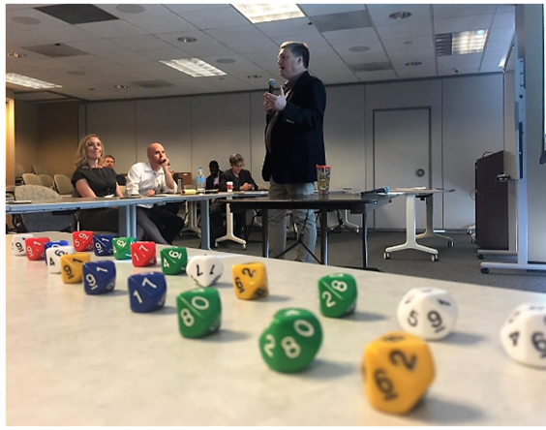
System Security and Testing, Step 4
Risk-Limiting Audit
  SOS sets a “risk limit” before every election.
    “means the largest statistical probability that an incorrect reported tabulation outcome is not detected and corrected in a risk-limiting audit.”
  Following tabulation, counties upload the tabulated results for each anonymous ballot
  Ten sided dice rolled 20 times to determine random seed
  Random seed determines ballots to be audited
  Bi-partisan election judges review ballot selected
  If tabulation for those ballots matches hand count (to satisfy risk limit) audit is complete
  If not, audit continues into 2nd, 3rd rounds as necessary

Slide 21
System Security and Testing, Step 4 (cont.)
Risk-Limiting Audit
  CO first in the country to adopt this on statewide level
  Possible because of paper ballot records
  Never failed a risk-limiting audit and no discrepancy has ever been due to tabulation machine error.

Slide 22
System Security and Testing – Common Questions/Misperceptions
  Q: Isn’t every system “hackable” and thus inherently not secure?
  A: CO mitigates this threat through use of system testing, paper ballots, post-election audits, and other physical security (seals, cameras, etc.).
  Q: Why can’t we just hand count everything?
  A: Hand counting is less accurate, more time consuming, and not realistic, particularly for Colorado’s lengthy ballots (several dozen races to count this upcoming general). Machines don’t get tired - election judges do.

Slide 23
Ballot Integrity, Overview
  What is it? Procedures in place to ensure that ballots were cast by registered voters, and that only those ballots cast by registered voters were counted.
  Basic Terminology:
    “Signature verification”
      The process of using a comparison of signature to confirm identity.
    “Canvass”
      Final act in an election. Certifies final abstract of votes.
    “Abstract of Votes Cast”
      Final official tally of votes in each race.

Slide 24
Ballot Integrity, Identification
Signature Verification:
  Primary method of identity verification in Colorado
  Election judges receive training before every election – must follow Signature Verification Guide
  Process
    Single judge verifies signature.
    If judge believes it does not match, signature goes to second tier of two election judges
    If all 3 agree signature does not match, signature placed into “cure status”
  Great NYT write-up of the process:
    https://www.nytimes.com/interactive/2020/10/07/upshot/mail-voting-ballots-signature-matching.html

Slide 25
Ballot Integrity, Maintaining Custody
Chain-of-Custody
  Transportation of ballots from locked drop boxes to central count completed in secure containers with bi-partisan judges.
  Ballot removal and tabulation conducted in secure location with limited access.
  All ballot processing conducted by bi-partisan judges in view of election watchers.
  After tabulation, ballots stored in secure containers with tamper-evident seals for 25 months.

Slide 26
Ballot Integrity, Canvassing
Canvass
  Last official act of the election
  Conducted by Republican-Democrat-clerk
  Duties:
    Ballots counted is < ballots cast
    Ballots cast < registered voters
    Certify the abstract of votes cast
  Confirms that additional ballots weren’t “stuffed” into the system

Slide 27
Ballot Integrity – Common Questions/Misperceptions
  Q: Are drop boxes safe?
  A: Yes. Drop boxes are secure metal containers, bolted to the ground, under video surveillance. Dropping ballots in a drop box removes the “middleman” USPS and ensures timely delivery of your ballot directly to election officials.

Slide 28
Where do we go from here?
Spread the good news! Colorado’s elections are safe, secure, and can be trusted.
Don’t take my word for it
  Talk to your county clerk
  Serve as an election judge or watcher
  Take a tour
Be skeptical of what you hear from outside sources
  Foreign governments and domestic actors use social media to spread disinformation
  Webpage on disinformation and what you can do about it here

Slide 29
Questions?
Call or email me with questions. If I don’t know the answer, I’ll try to find someone who does.
  303-894-2200 ext. 6386
  Caleb.Thornton@coloradosos.gov

Slide 30
CLE Credit
Logon to CLE tracker enter Course ID: 838829

Slide 31
CDOS Continuing Legal Education Reminder
Variety of topics - Title Board, Cybersecurity, Notary, and more!
Once per month through October
Visit online to sign-up at: https://www.coloradosos.gov/pubs/info_center/CLEseminars.html
Next session – July 11, “What is Title Board?”

