Slide 1
Continuing Legal Education
Colorado Department of State

Slide 2

10 most wanted
Identifying violations of the Revised Uniform Law on Notarial Acts

Slide 3

Course topics
10 Most Wanted List
  Most common ways notaries get in trouble
Sovereign Citizens
  What to watch out for
Coercion and Fraud
  How to protect elderly and vulnerable clients
  Latest forms of fraud
Resources
  Ways to check yourself so you don’t end up on the lam

Slide 4


10 most wanted list
Lack of physical presence
Notary did not identify the signer
Blanks
Disqualifying interest
Criminal history
Incomplete journal
Incorrect/missing notarial certificate
Non-compliant stamp
Incorrect signature
Unlicensed practice of law

Slide 5

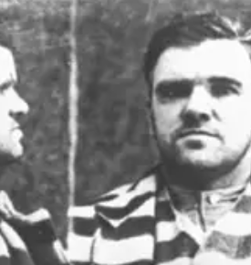

Personal Presence “Blue Eyes” Mcgee
Occupation: Boss
Racket: You name it, I’ve probably done it
Sentence: Revocation

Slide 6
Personal appearance required
24-21-506, C.R.S.
If a notarial act relates to a statement made in or a signature executed on a record, the individual making the statement or executing the signature shall appear personally before the notarial officer.

Slide 7
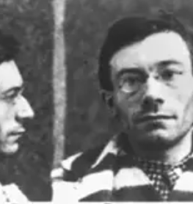
NO I.D. Malone
Occupation: The friend of a friend, Speakeasy owner
Racket: Hey, I don’t want any trouble, okay?
Sentence: Revocation

Slide 8
Identification of Individual
24-21-507, C.R.S.
Notary may identify using:
  Personal knowledge
  Credible witness
  Satisfactory evidence
    Government Issued ID
    Not expired more than one year
Notary can request additional credentials

Slide 9
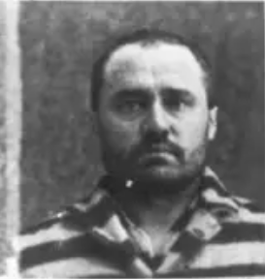
Blanks O’Connor
Occupation: Corrupt Politician
Racket: Hey, I just take what’s offered to me, okay? Nothin’ wrong with that
Sentence: Suspension for term

Slide 10
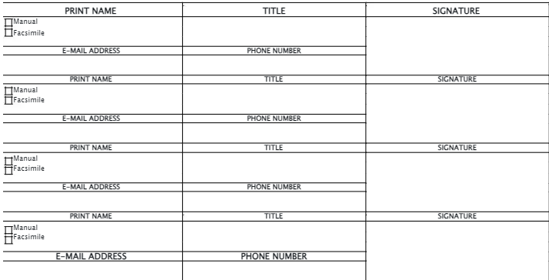
Blanks are not allowed
24-21-525(7), C.R.S.
A notary public shall not perform any notarial act with respect to a record that is blank or that contains unfilled blanks in its text.
Signature banks

Slide 11
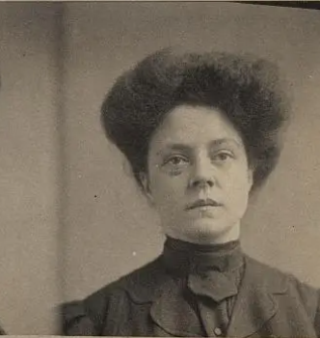
Debra “the Disqualifier” Ramono
Occupation: Mob wife
Racket: Nothing, I don’t get “involved” in my spouse’s work
Sentence: 6-month suspension

Slide 12
Disqualifying Interest
24-21-504, C.R.S.
A notary may not perform a notarization when:
  The notary is a party to or named in the document
  The notary’s spouse, partner, ancestor, descendent, or sibling is a party to or named in the document
  The notary will receive a benefit from the document other than the notary fee
  The notary’s spouse, partner, ancestor, descendent, or sibling will receive a benefit
Notarizations for employer
Interpreters

Slide 13
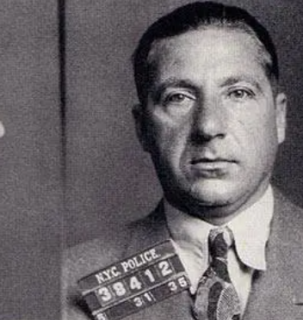
Triggerfinger Montano
Occupation: Professional bad guy
Racket: Hitman
Sentence: Revocation

Slide 14
Criminal History
24-21-523(1)(c), C.R.S.
The Secretary of State may deny, refuse to renew, revoke, suspend, or impose a condition on the notary for:
  A conviction of the applicant or notary public for any felony or, in the prior five years, a misdemeanor involving dishonesty
Oath on application
Complaints

Slide 15
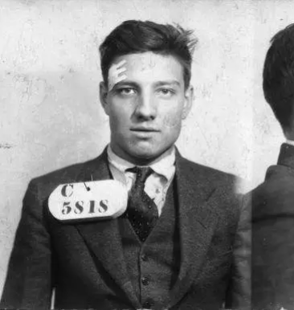
Jack the Incomplete
Occupation: Bookkeeper
Racket: Fixing the books
Sentence: Suspension pending training

Slide 16
Journal Required
24-21-519, C.R.S.
Journal requires:
  Date
  Time
  Type of document
  Type of notarial act
  Full name and address of the person for whom the notarization was performed
  Signature of customer
  Type of identification used
  Fee
Remote notarizations
Notarizations using interpreters
Exception to journal requirement, 24-21-519(10)(c), C.R.S.

Slide 17
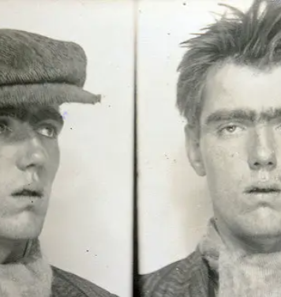
Neall “The notary” McConnel
Occupation: Notary
Racket: Pre- and Post-Dated Notarizations
Sentence: 6-month suspension

Slide 18
Notarial Certificate Must Be Complete
24-21-515 and 516, C.R.S.
Notarial certificate requires:
  State
  County
  Date of notarization
  Type of notarial act
  Official notary signature
  Notary Title
  Notary stamp
Notary may not pre or post-date notarial certificates
Corrections

Slide 19
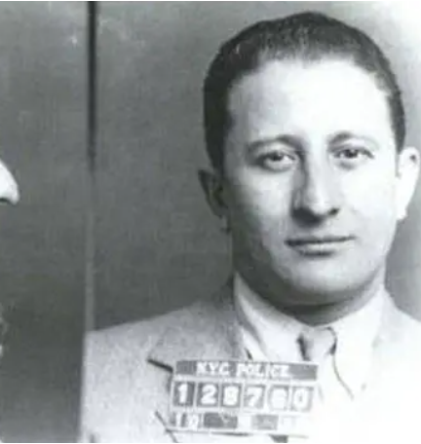
Nicolas the Noncompliant
Occupation: Stamp Maker
Racket: Creating fake papers
Sentence: Admonishment

Slide 20
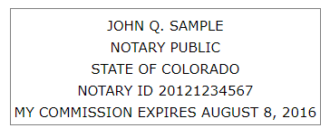
Notary Stamp
24-21-517 and 518, C.R.S.
Stamp must:
  Be rubber
  Be rectangular with a rectangle border
  Contain notary’s name as it appears on commission certificate
  Contain notary ID
  Contain expiration date
  Contain the words “state of Colorado”
  Contain the words “notary public”

Slide 21
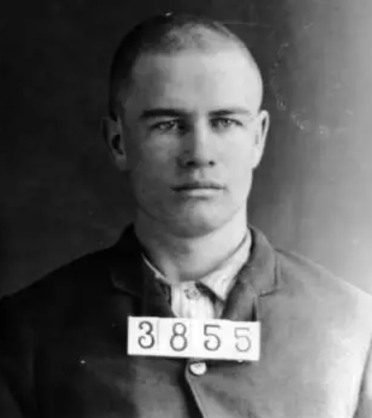
The Executor
Occupation: Secretary
Racket: Forges Signatures
Sentence: Admonishment

Slide 22
Notary Signature
24-21-515 and 516, C.R.S.
The notary signature must be signed in the same manner as on file with the Secretary of State
Signature does not need to match name on commission certificate

Slide 23
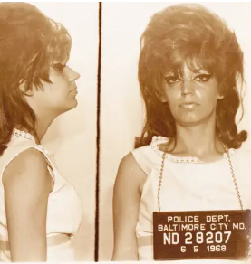
Alice “The Advisor” Bevil
Occupation: Paralegal
Racket: Provides cheap legal advice
Sentence: Revocation

Slide 24
Unauthorized Practice of Law
24-21-523(1)(i) and 24-21-525, C.R.S.
Unless a notary is also an attorney in Colorado, they may not:
  Draft legal records
  Give legal advice
  Practice law
  Act as immigration consultant or expert on immigration
  Represent someone in judicial or administrative proceedings
  Receive compensation for legal advice
  Engage in false or deceptive advertising
  Use the term “notario” or “notario publico”
  Engage in deceptive trade practices

Slide 25
Sovereign Citizens
Believe they are not under the jurisdiction of the U.S. Government and that they are exempt from U.S. Laws
The FBI has designated sovereign citizens as domestic terrorists
Often have documents that are filled with legalese and cite the U.S. Constitution and the Uniform Commercial Code, though often incorrectly
May ask for certified copies
May ask for you to perform oaths/affirmations
They may add a red thumbprint, a bloody thumbprint, or USPS stamps to their signatures
Many times, they will add a copyright symbol to their names
You must follow all notary laws when notarizing these documents
You have the right to refuse to perform notarial acts as long as it is not for a reason prohibited by law, like discrimination

Slide 26
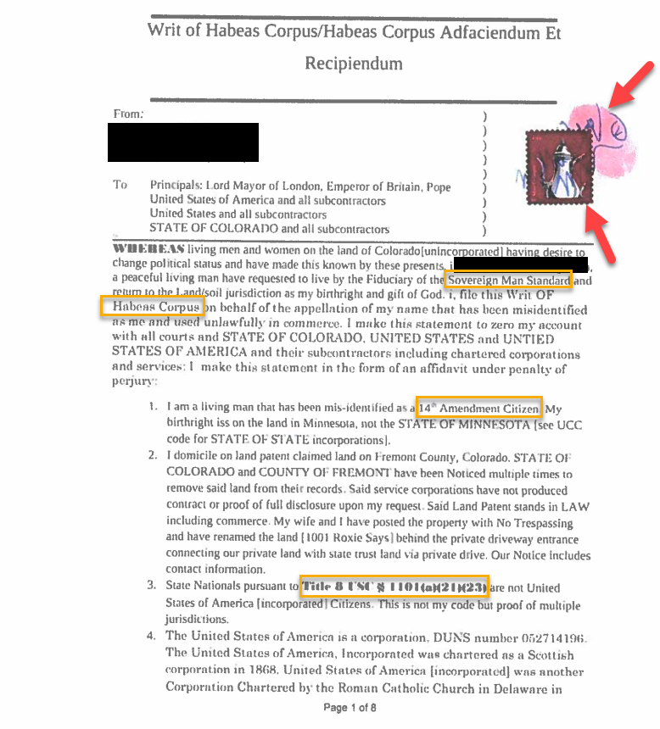
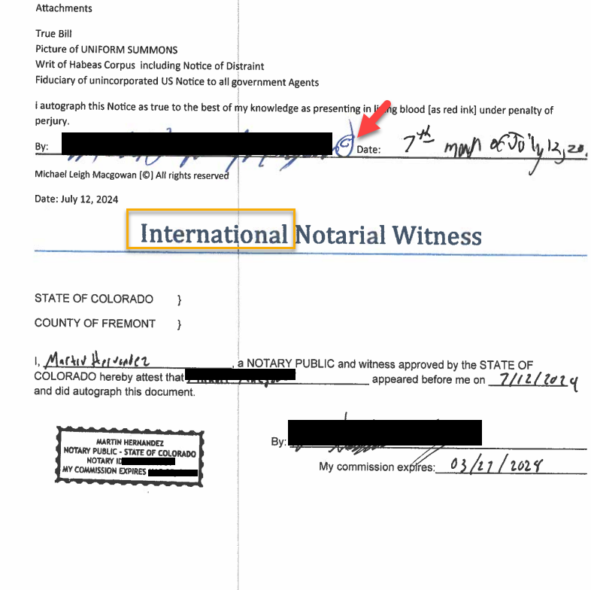
Sovereign Examples 1

Slide 27
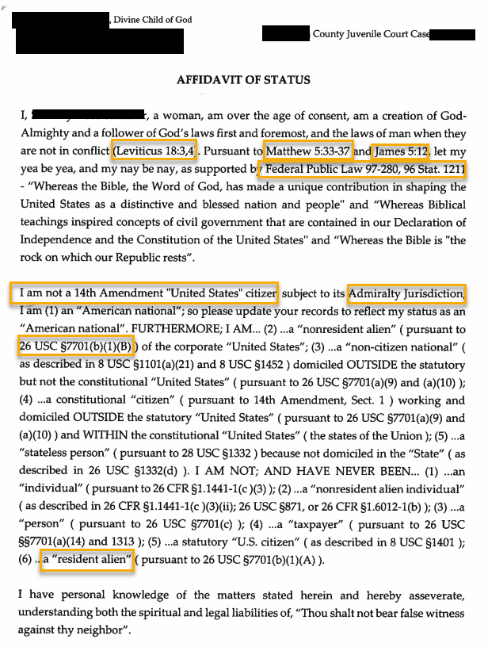
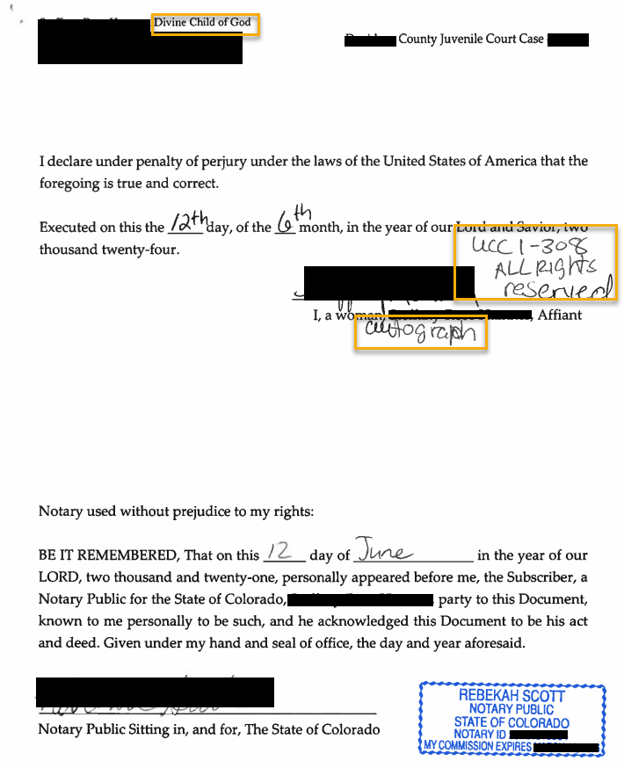
Sovereign Examples 2

Slide 28
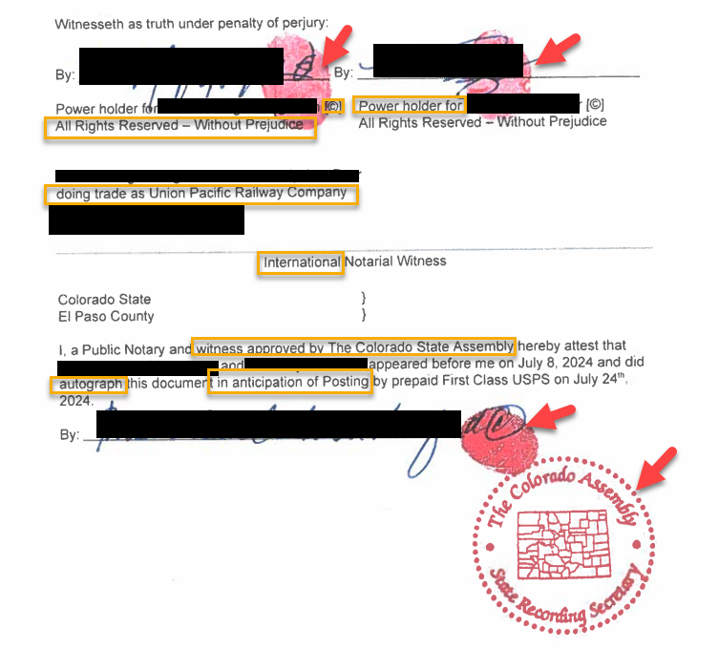
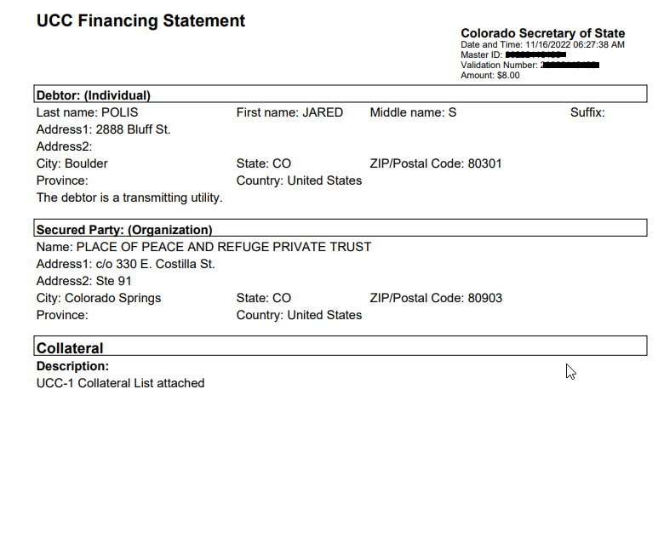
Sovereign Examples 3

Slide 29
Coercion and fraud
Notary is the main barrier to fraud
Notary’s responsibilities are to the people of Colorado
Secretary of State takes a special interest in protecting elderly and vulnerable residents
Check for lucidity, understanding, and that person is acting of own free will

Slide 30
New Types Of fraud
Selling open land
Transactions completely remote
Covenants not to sell

Slide 31
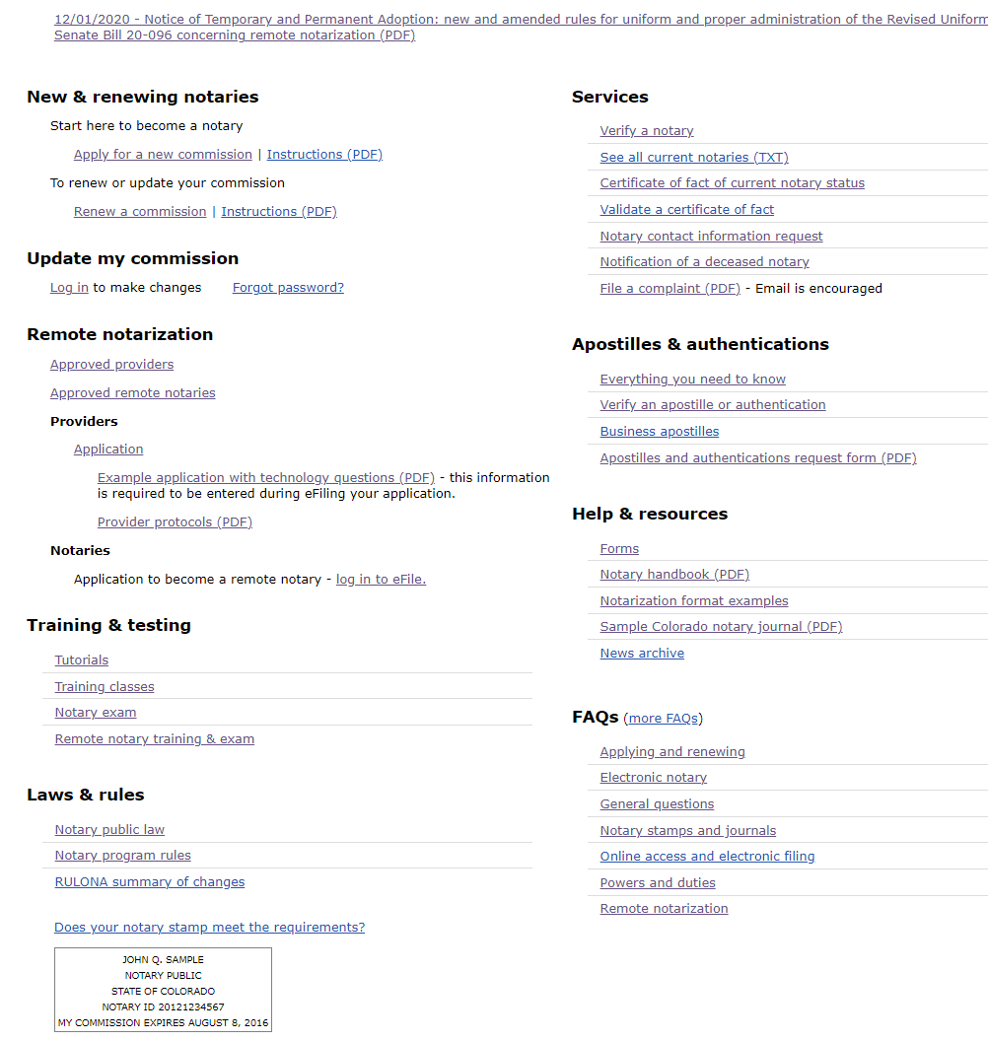
Resources
Administrative Procedure Act:
  https://www.coloradosos.gov/pubs/info_center/laws/Title24/Title24Article4.html
Notary Home Page
  https://www.sos.state.co.us/pubs/notary/home.html?menuheaders=7

Slide 32

Contact Me
Notary@coloradosos.gov

Slide 33
Future CLE Classes
The Purcell Principle
  October 8, 2024
  Purcell v. Gonzalez
  Elections
Public Data Fundamentals for Lawyers
  November 14, 2024
  How to leverage public data
  Available resources

Slide 34
CLE Course ID
Course ID: 838825

Slide 35
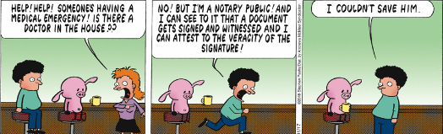
Questions and Answers

