Slide 1
Bipartisan Election Advisory Committee
December 15, 2016

Slide 2
Ballot measure implementation
Proposition 107 (presidential primary)
  Beginning in 2020
  Major political parties
  No later than the 3rd Tuesday in March
  Affiliated voters mailed party ballot
  Unaffiliated voters mailed single, combined ballot; or separate party ballots
  Unaffiliated voters may vote for only one party
  Ballot may only contain President/Vice President race

Slide 3
Ballot measure implementation
Proposition 108 (state primary)
  Beginning in 2018
  Affiliated voters mailed party ballot
  Unaffiliated voters mailed single, combined ballot; or separate party ballots
  Unaffiliated voters may vote for only one party
  Voter not required to vote in the same party primary as he/she voted in the presidential primary
  Political party may opt out of primary and instead nominate candidates by party convention

Slide 4
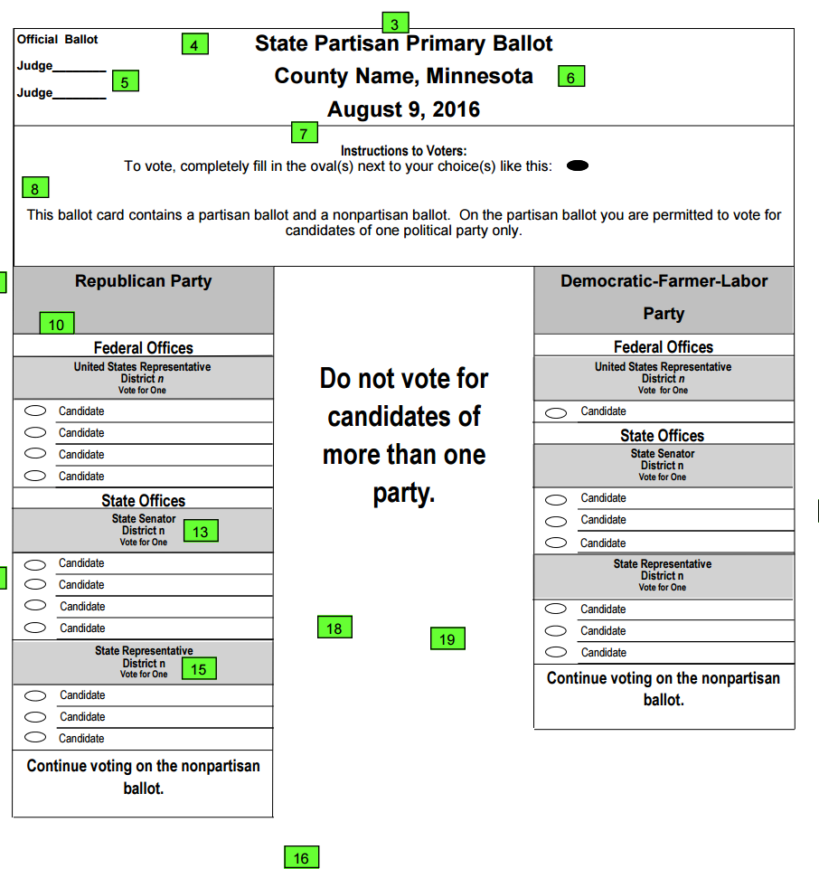
Combined ballot - Other states
Minnesota
  “This ballot card contains a partisan ballot and a nonpartisan ballot. On the partisan ballot you are permitted to vote for candidates of one political party only.”

Slide 5
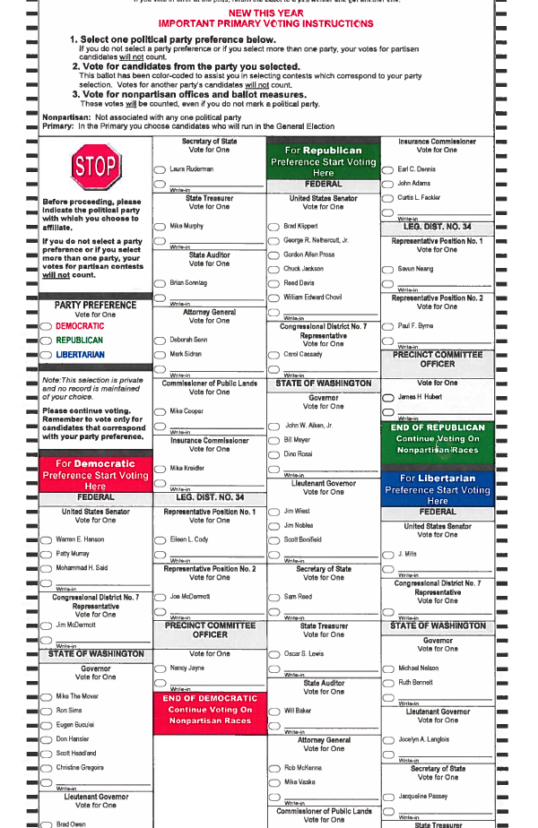
Combined ballot –
Other states
Washington
  “Select one political party preference below.”
    “If you do not select a party preference or if you select more than one party, your votes for partisan candidates will not count.”
  “Vote for candidates from the party you selected.”
    “This ballot has been color-coded to assist you in selecting contests which correspond to your party selection. Votes for another party’s candidates will not count.”
  “Vote for nonpartisan office and ballot measures.”
    “These votes will be counted, even if you do not mark a political party.”

Slide 6
Ballot measure implementation
Rulemaking authority
  Proposition 107/108
  “The Secretary of State may by rule adopt additional ballot requirements necessary to avoid voter confusion in voting”
Funding
  Presidential primary reimbursement formula
    Counties with 10,000 or fewer active registered voters receive 90 cents per active voter.
    Counties with more than 10,000 active registered voters receive 80 cents per active voter.

Slide 7
Ballot measure implementation
Amendment 71
  In addition to signature requirements under current law, proponents of an initiated constitutional amendment must collect signatures equal to 2% of the registered voters in each of Colorado’s 35 senate districts to get on the ballot.
  Ballot measures proposing constitutional amendments must receive at least 55% of the vote to pass. (Except measures proposing repeal of constitutional amendments, which only need 50% of the vote to pass.)
  Potential legislative proposal:
    Random sample process

Slide 8
Potential legislative proposals
Initiative petition review procedures
  Signature verification
  Electronic signature collection
  Cure procedures
  Repeal unnecessary provisions

Slide 9
Potential legislative proposals
Ballot access and vacancy process cleanup
  Revise partisan vacancy process
  Clarify when the designated election official may remove unqualified candidates from the ballot
  Change candidate petition deadlines to provide more time for designated election officials to review them
  Update candidate petition cure procedures

Slide 10
Potential legislative proposals
Campaign finance
  Clarify distinction between independent expenditure committees and political committees
  Clarify LLC contribution requirements
  Prohibit personal use of campaign funds
  Codify requirement to identify candidate referred to in electioneering communication reports
  Eliminate Independent Expenditure donor reports
  Eliminate Major Contributor reports for certain committees during certain periods
  Clarify reporting requirements for school board candidates
  Procedural changes to Complaint process – referral to OAC, attorneys fees, subpoenas, and collection of debt

Slide 11
Potential legislative proposals
Election Watchers
  Authorizes state party chair as alternative appointing entity
  Moves up date for submittal of names to county clerk
  Authorizes registered agent of issue committee to appoint
  Outlines process and remedy for reporting potential discrepancy
  Codifies election watcher oath
  Requires criminal background checks to observe tier two signature verification

Slide 12
Potential legislative proposals
Voter Service and Polling Centers
  Re-work formulas for number of locations, length of time open
      General election – VSPCs for 15 days before and including election day
        Large counties (25,000+ active electors) – 1 VSPC per 30,000 active voters (early voting); 1 VSPC per 15,000 active voters (election day)
        Medium counties (10,000 – 25,000 active electors) – at least one VSPC (early voting); at least 3 VSPCs (election day)
        Small counties (fewer than 10,000 active voters) – at least one VSPC (early voting and election day)
      Primary/coordinated election – VSPCs for 8 days before and including election day
        Large counties (25,000+ active electors) – As many VSPCs as county motor vehicle offices; at least one VSPC
        Other counties (fewer than 25,000 electors) – at least one VSPC required; more as necessary
      “Reasonable business hours” – at least eight hours per day Monday through Friday; at least four hours on Saturdays; 7:00 a.m. – 7:00 p.m. on election day

Slide 13
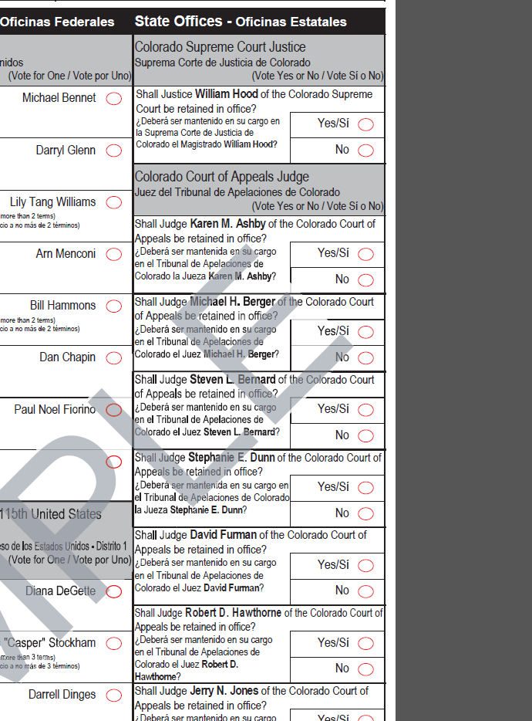
Constitutional Amendment
Judicial retention (ballot language)
Amend Art. VI, Sec. 25 of Colorado Constitution
“Shall Justice (Judge) … of the Supreme (or other) court be retained in office? YES/…/NO/…/.”
Proposed new header language
  “Shall the following Justices (Judges) of the Supreme (or other) court be retained in office?”

