Slide 1
Colorado Department of Local Affairs
Natriece Bryant, Deputy Executive Director
Colorado.gov/census2020

Slide 2
It’s Important
Representation
Distribution of Federal Funds - $13 billion in Colo.
Inform state and local decision-making
It’s Easy
10 questions, 10 minutes, online, phone, paper, in person
It’s Safe
All respondent data and information is protected by law.

Slide 3
Census 2020 = Colorado Funding
$883 billion in federal funding allocated in US based on Census population counts
Approx. Colorado funding per year = $13 billion
Senior services (Medicare)
Public libraries
Health services (Medicaid)
Community centers
Road improvements
Public Housing (Section 8)
Title 1 Grants to Local Education Agencies
Programs for Veterans
Community colleges
Tuition assistance
Women, Infants & Children (WIC)
Public Assistance (SNAP)
School Lunch
Health Centers
http://bit.ly/2EdYLbT: Based on George Washington Univ. Study

Slide 5
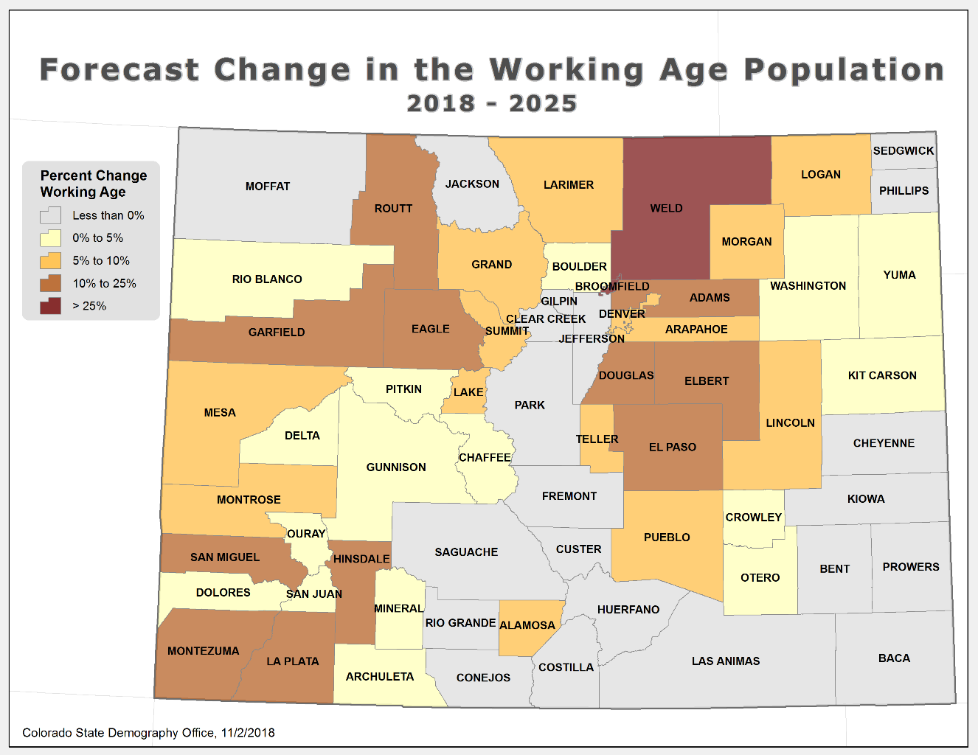

Slide 6
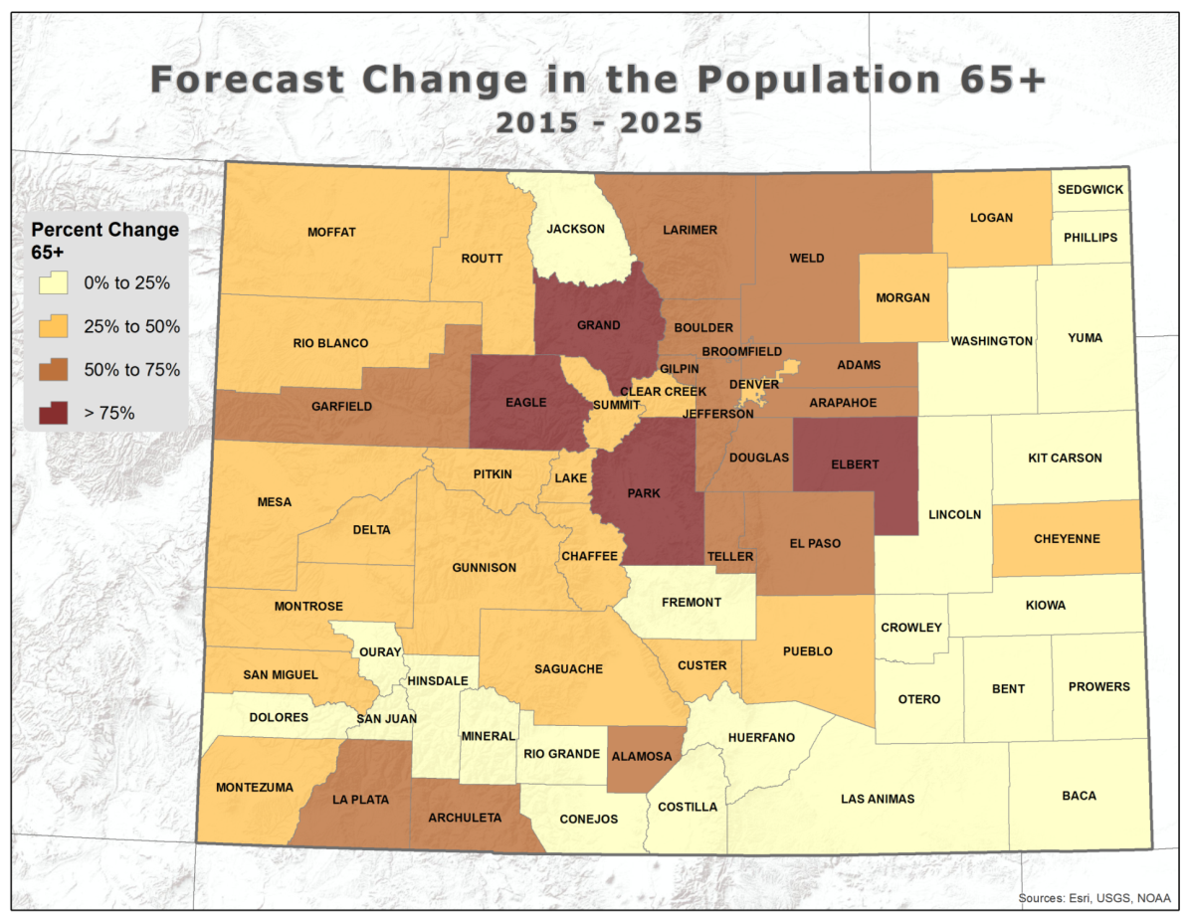

Slide 7
Reapportionment – Projection
Notes:
Blocks and Precincts – 2017
Municipal Boundaries – annual
Block Groups, Tracts, Census Designated Places – Important for collecting data describing areas of interest - January 2019
Update Housing Units and Group Quarters
Local Update of Census Addresses (LUCA) – 2018
Group Quarter Update – Jan – June 2019
New Construction – 2019-2020
Count Review – March-July 2020

Slide 8
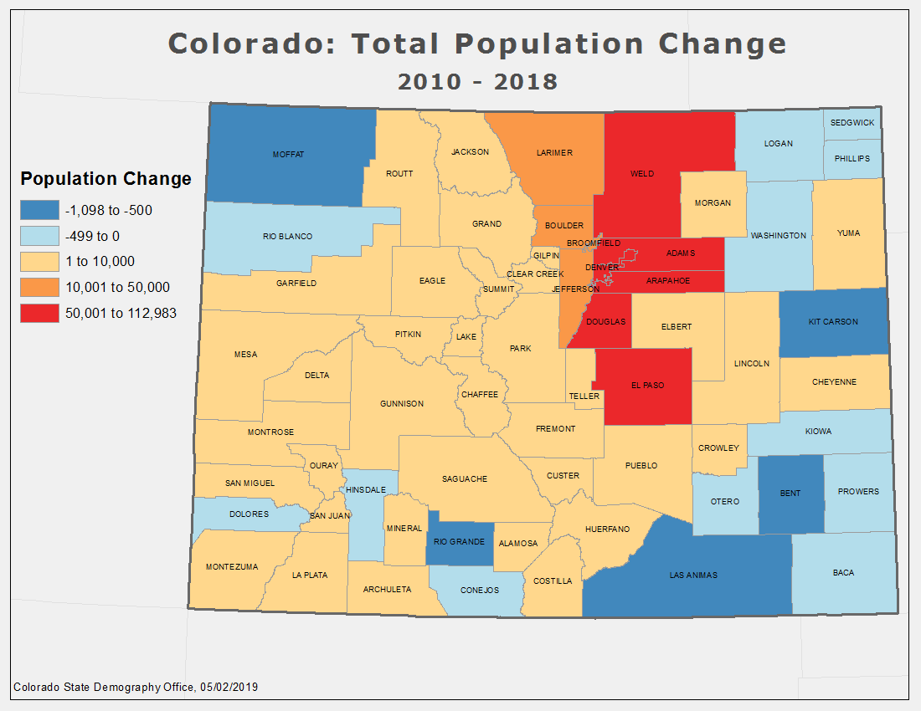
Notes:
Blocks and Precincts – 2017
Municipal Boundaries – annual
Block Groups, Tracts, Census Designated Places – Important for collecting data describing areas of interest - January 2019
Update Housing Units and Group Quarters
Local Update of Census Addresses (LUCA) – 2018
Group Quarter Update – Jan – June 2019
New Construction – 2019-2020
Count Review – March-July 2020

Slide 9
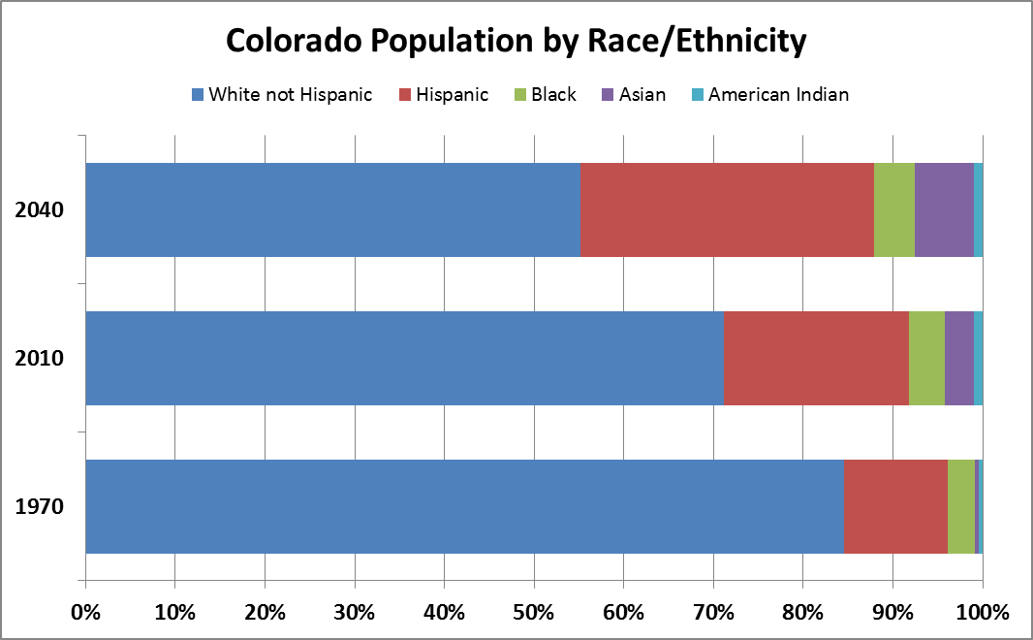

Slide 10
Community Engagement and Partnership Program
Notes:
Blocks and Precincts – 2017
Municipal Boundaries – annual
Block Groups, Tracts, Census Designated Places – Important for collecting data describing areas of interest - January 2019
Update Housing Units and Group Quarters
Local Update of Census Addresses (LUCA) – 2018
Group Quarter Update – Jan – June 2019
New Construction – 2019-2020
Count Review – March-July 2020

Slide 11
What is the State’s Role?
State Complete Count Campaign (CCC)
Funding Census 2020 Outreach Program
Funding for marketing materials through DOLA’s State Demography Office
Collaborate and with the Census Bureau
Collaborate and support local governments and organization.
Leverage ideas and work across the state

Slide 12
What Has Colorado Done to Date
Goal – Count everyone, once and in the right place
Housing units and boundaries are the foundation for a successful Census.
Updating the Master Address File for all housing in Colorado.
Update the list of all Group Quarter facilities (prisons, nursing homes, college dorms)
Updating all boundaries – precincts, census tracts, census block groups and municipal boundaries.
Notes:
Blocks and Precincts – 2017
Municipal Boundaries – annual
Block Groups, Tracts, Census Designated Places – Important for collecting data describing areas of interest - January 2019
Update Housing Units and Group Quarters
Local Update of Census Addresses (LUCA) – 2018
Group Quarter Update – Jan – June 2019
New Construction – 2019-2020
Count Review – March-July 2020

Slide 13
Colorado 2020 Census Support Program
$220K in funding and is limited to $2,500 per organization.
The Colorado 2020 Census Support Program (CCSP) is designed to support the outreach efforts of local governments and partner organizations by providing promotional materials to better reach hard-to-count populations and improve self-response rates to Census 2020.
Specifically designed for local governments and partner organizations who are actively involved providing education and outreach for Census 2020 and are involved with a Complete Count Committee/Campaign.

Slide 14
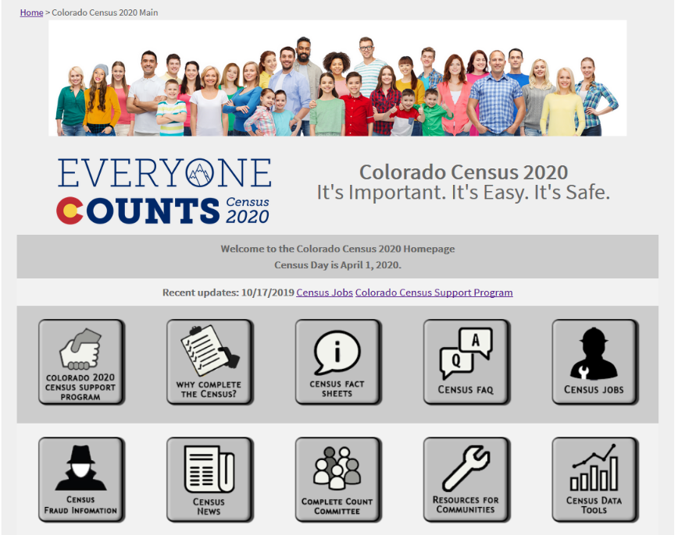
Educate, Engage, Encourage

Slide 15
You Can’t Spell Census without “Us”
Notes:
Blocks and Precincts – 2017
Municipal Boundaries – annual
Block Groups, Tracts, Census Designated Places – Important for collecting data describing areas of interest - January 2019
Update Housing Units and Group Quarters
Local Update of Census Addresses (LUCA) – 2018
Group Quarter Update – Jan – June 2019
New Construction – 2019-2020
Count Review – March-July 2020

Slide 16
Census 2020 - 13 Languages

Slide 17
State Complete Count Campaign
Goal: To increase awareness about Census 2020 and to motivate residents to respond with the result of the best and most accurate count in Colorado.
Subcommittees:
Education and Youth Communications/Outreach
Higher Education Rural Colorado
Policy Immigrant/Refugee/POC
Business and Nonprofits Local & State Government

Slide 18
Colorado Action Plan
Tactics for Execution
School Friday folder inserts
Library outreach – assistance centers
Develop “drop in” articles for specified newsletters
Census Link on student portals/school newsletters through school districts
PSAs from trusted voices/various languages – Secretary of State
Engagement of Re-Entry Population
Develop targeted messaging through web and social media – November 19th (posted online)
VITA Tax Preparation Assistance Centers – live in March 2020

Slide 19
Census Jobs Nearly 40,000 Applicants Needed in Colorado!
SNAP Waiver and TANF 90 day Waiver
Excellent
Pay

Slide 20
Colorado Resources
Colorado Census 2020 Website: www.colorado.gov/census2020
Department of Local Affairs – Natriece Bryant Natriece.Bryant@state.co.us 303-864-7707

Slide 21
Questions?

