Slide 1


SOS Business Registry
and ID Verification
The value of checking and verifying Identities
Larry Benson, Author of Fraud of the Day & Director of Strategic Alliances, LexisNexis® Risk Solutions
October 2022

Slide 2
01
  Business Identity Theft and Fraud
  Properties of Business Identities
  Challenges of Business Verification
  Sought after identities
  Published Scams
Agenda
02
03
04
05

Slide 3




Issues with Business Identity Theft and Fraud
Easy to do
    Create a business
    Impersonate a business
    Shell Company
    Shelf Company
Challenging to vet a business
Goes unreported
Goes unprosecuted

Slide 4

What Distinguishes Business Identity
What Can I Use to Connect the Dots?
Agents
Type
Date of Incorporation
Licenses and Permits
Locations
Officers
Email
Addresses
Industry Codes
DBAs
Cell Phone
Numbers
Business Name
Owners
Relatives and Associates
Office Phone Number(s)
Do I have what I need to connect with businesses?

Slide 5
Business Identity Data is Organic
Businesses change, evolve, disappear and even reappear.
Businesses and owners can be messy, evolve and misrepresent themselves
Gaps in information
Old information
Inaccurate information
Changes in Business names and types
  33 million existing businesses
  900,000 new businesses are created annually
  Shell Companies and Shelf Companies muddy the water
  Corporate Data is readily available
  EIN# are published, check an annual report
  Signature of the CFO is published
  Information is available on the Secretary of State web site.
  Companies with name variations and umbrellas.
  Companies have multiple sites and delivery locations.
  Estimated 7-11% of businesses may be ‘hiding in the shadows’
  (unregistered or non-reporting) Approximately 2.5-3 Million businesses.
Changes in owner or officer names
Multiple addresses from businesses
Address changes
Sanctions and watch lists changes
Multiple phone numbers
Multiple or no TINs
Multiple EINs or no EINs
Industry code discrepancies

Slide 6
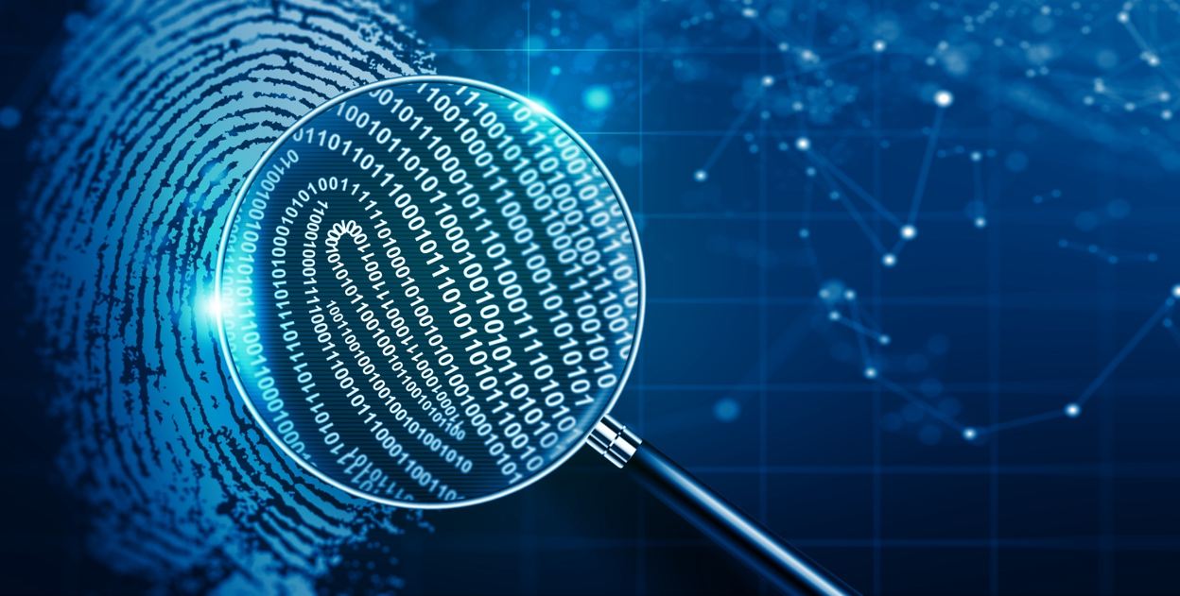
Corporate Verification – Can These be Faked?
01
02
03
04
05
  Secretary of State – Registered and current standing
  DUNS # and registration
  EIN #
  Web site verification
  Customer reviews
How many fake businesses are formed?
Will they check the submitted information or just rubber stamp the loan?
Notes:
While we have streamlined some of the processes and workflows from the past, the fact is that the Claims Industry is still basically doing the same things albeit differently. How many of you have heard the saying, “what got you here won’t get you there?” That saying could apply to our claims processes and what the future holds. What we know is that your current claims processes are less efficient than needed to face the coming changes brought on by changing customer expectations, driverless vehicles, and introduction of new medical providers driven into the P&C claims market by the continued advancement of the Affordable Care Act. What we know is that the staffing challenges predicted as early as 2007 are now coming to fruition – your most tenured reps upon whom you relied to handle claims with great efficiency and to recognized potential fraud and subrogation opportunities are aging out of the industry and fewer quality candidates are choosing to enter the Claims market. If you do find one, they expect to have the most advanced tools with which to carry out their jobs. If you don’t have those tools, they are willing to leave to work for those who do. And finally, the number and sophistication of fraud cases is increasing, and your approach and tools used to identify that fraud must evolve or you will become a prime target for exploitation.
So, what does doing different things rather than doing things differently look like? As an example, I would like to use something as mundane as deciding what to cook for dinner

Slide 7

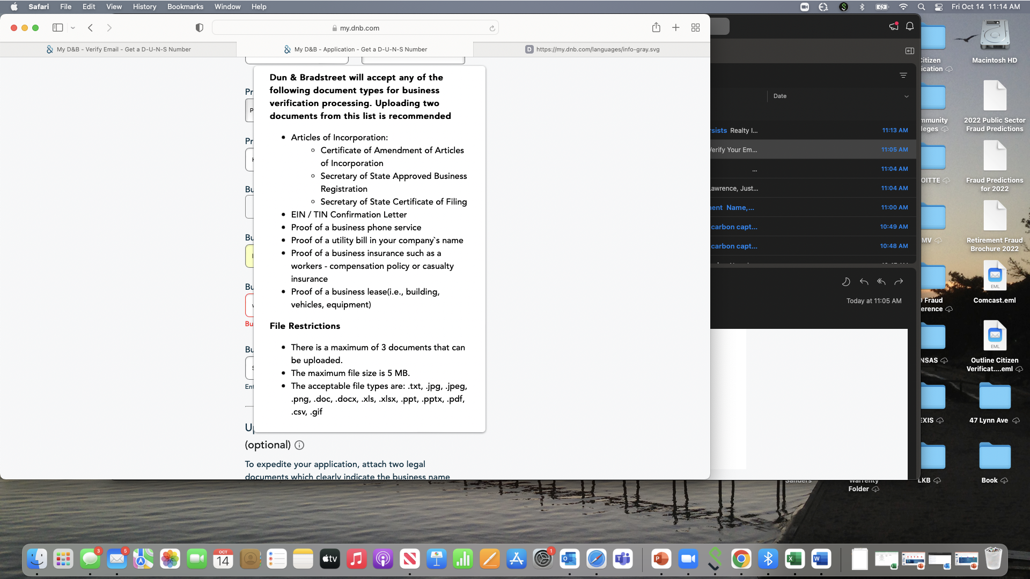

Slide 8
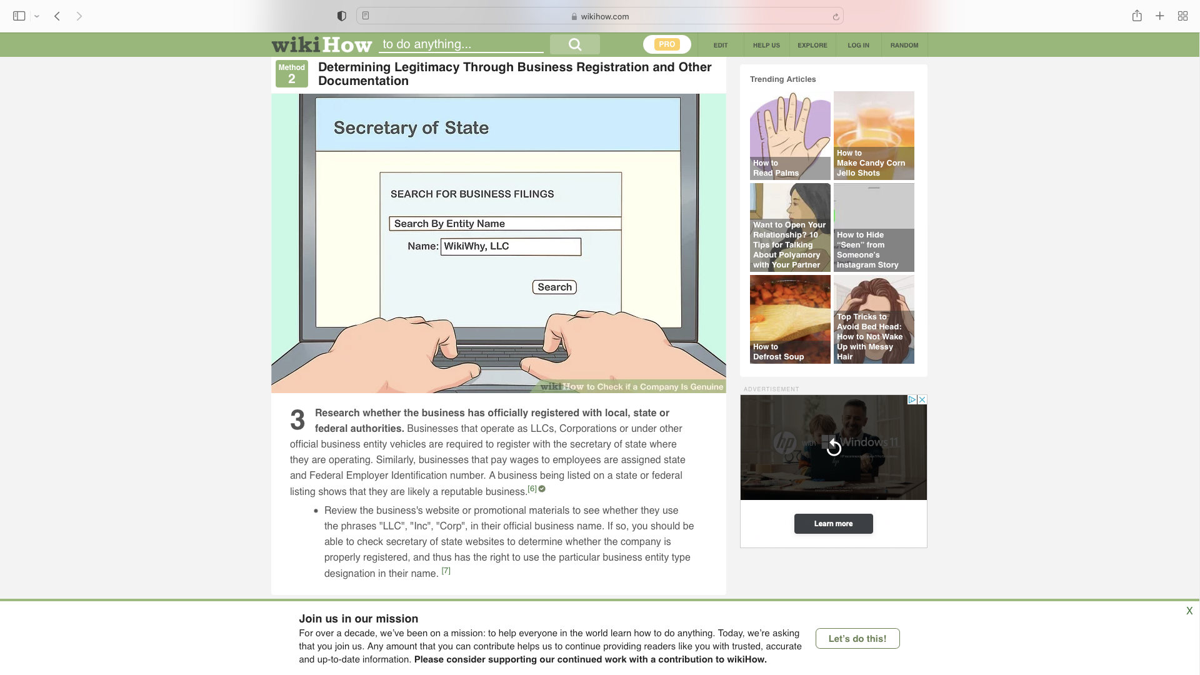
How to Check if a Company Is Genuine
Commercial and
public expectations

Slide 9
Companies Don’t Commit Fraud, People Do
They change, evolve and connections of risk tend to hide behind them
  Traditionally Who Commits Business Fraud?
  Owners
  Officers
    Board members
    Senior staff
  Agents
  Employees
  Who are the new players
  Outside third parties
  Off-shore organized crime rings
  Not everyone fits in the same box
  name modifications
  Not everyone has an SSN, or ITIN.
  Address variations, RR#35, Seidersville Rd.
  People change
  Marriages, divorces (over 3M times per year)
  35 million people move each year.
  Moving (40% of movers ignore USPS, 69% under 34 years old)
  Phone numbers, 321M active cell #s
  People Die, 2.8 Million /yr.
  SSN reassignment, over 5 Million
  People lie (People have life events)
  Incarcerated (1.6M, over 4M on parole)
  3.9M births/yr.
  Intentional SSN modifications
  SSNs (Lexis often sees 1-10% of people with multiple SSNs)
  NCOA is criminal’s best resource for mail fraud
Notes:
Put in the front

Slide 10





Sought After Identities by Identity Thieves
Deceased
Elderly in
retirement
homes
Puerto Rican
identities
Severely
Handicapped
Prisoners
Kids:
  Start with a clean history
  Not usually monitored by parents
  They can be used for years without detection
  Friendly Fraud – Relatives even mom and dad, It’s a family Affair.
Notes:
The process of meal-planning, shopping and identifying the right ingredients, and cooking the meal can be broken down into three activities <key word art>. Tie them together
The same is true in Claims processing. While we all know that an activity that may need to be completed on one claim may not need to be done on another, the fact is that these three activities almost always occur on every claim.
Acquire data – FNOL process, recorded statement, inspections, medical bills, etc.
Analyze data
Act on data

Slide 11

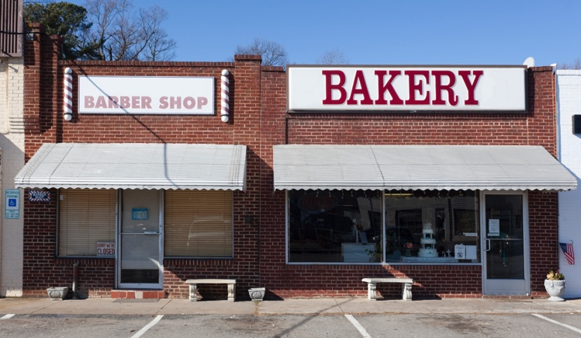
New deceased fraud ring
2,305 people died in the same year, at same address, for similar refund amounts? – highly improbable.
Address is actually a mailbox store
Flagged these refunds as newly deceased and not seen at input address and the best address is Out-of-State.
The fraudster made a mailbox store look like an apartment building using one address with different Apt numbers for $16,674,911 in refunds.
All data has been altered for privacy reasons but is consistent
to the actual network of fraud

Slide 12

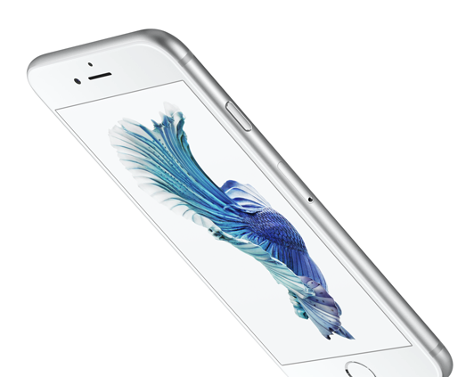


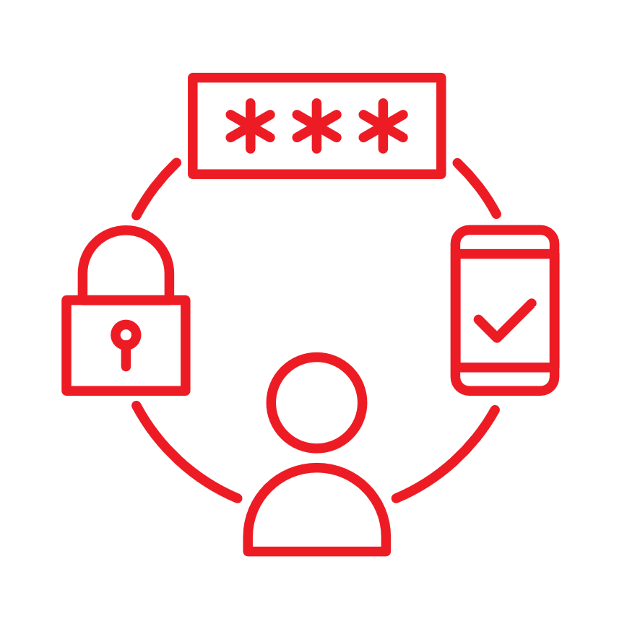



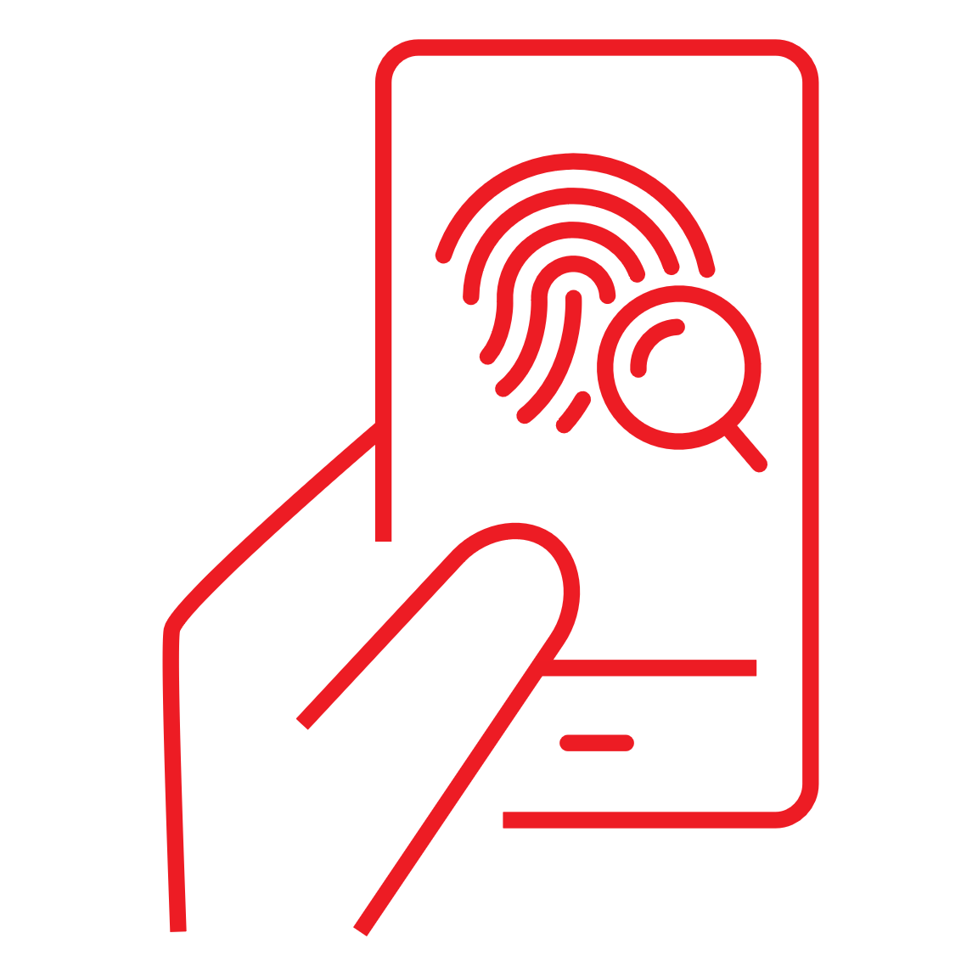
The Digital Age – Digital Identities
  ****
  IP Address
  Phone-based
  4-6 digit codes
  Passwords
  KBA and state credential verification
  Consortium (Token) based aggregation – Location, Physical ID, Credit card, IP address
  Computer based biometrics – Your interaction with the device becomes your identity
Notes:
While we have streamlined some of the processes and workflows from the past, the fact is that the Claims Industry is still basically doing the same things albeit differently. How many of you have heard the saying, “what got you here won’t get you there?” That saying could apply to our claims processes and what the future holds. What we know is that your current claims processes are less efficient than needed to face the coming changes brought on by changing customer expectations, driverless vehicles, and introduction of new medical providers driven into the P&C claims market by the continued advancement of the Affordable Care Act. What we know is that the staffing challenges predicted as early as 2007 are now coming to fruition – your most tenured reps upon whom you relied to handle claims with great efficiency and to recognized potential fraud and subrogation opportunities are aging out of the industry and fewer quality candidates are choosing to enter the Claims market. If you do find one, they expect to have the most advanced tools with which to carry out their jobs. If you don’t have those tools, they are willing to leave to work for those who do. And finally, the number and sophistication of fraud cases is increasing, and your approach and tools used to identify that fraud must evolve or you will become a prime target for exploitation.
So, what does doing different things rather than doing things differently look like? As an example, I would like to use something as mundane as deciding what to cook for dinner

Slide 13

Business Identity Scams
The Insider
The Outsider
International Organized Crime
Name modification
GE VS. GE Enterprises – $460k check – Shell company/bank accounts under the similar name, different state with a fake Identity.
Address modification
Same company name, and in the same location, but different floor. fake identities, 1,000 cell phones.
Fake Company
Created a “Construction company”. Weekly rented cars under a fake ID. Drove off with 14 Luxury cars.
Business Fraud is usually unreported – embarrassment, lots of explaining to a board or stockholders,
“Make it disappear”

Slide 14

Would You… ?
01
  Issue a drivers license without checking the identity of the applicant?
02
  Open a bank account without ID verification?
03
  Issue an insurance policy without authenticating the customer?
  Does it make sense to allow the creation of a legal business entity without identity verification?
04

Slide 15
QUESTIONS?
Larry Benson
Director, Strategic Alliances
LexisNexis Risk Solutions
Cell 781-439-3198
Lawrence.benson@LNSSI.com
Creator of LexisNexis - Fraud of the Day
Author of WTF? Where’s The Fraud, and Data Personified.

