Slide 1
Colorado Department of State Judd Choate, State Election Director
BEAC Meeting: Colorado’s 2022 Primary Election
August 18, 2022
303-869-4927
judd.choate@coloradosos.gov

Slide 2
2022 Primary Turnout Data

Slide 3
Registration By Party 2014-2022

Slide 4
2022 Primary Turnout by Party

Slide 5
2022 Primary Unaffiliated Ballot Selection Numbers

Slide 6
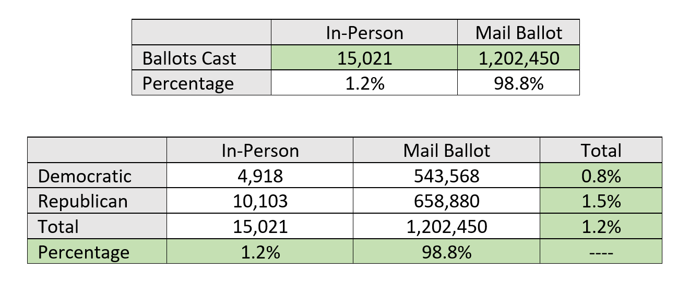
2022 Primary In-Person Numbers

Slide 7
2022 Primary Election VSPC Usage by Day

Slide 8
2022 Primary Election In-Person Voting by Method

Slide 9
2022 Primary BallotTrax Data

Slide 10
2022 Primary Election BallotTrax Facts
Voter registration
3,797,380 registered Colorado voters
1,980,756 registered BallotTrax users (52%)
2022 Primary voter turnout
32.15% Colorado Active Registered Voters
35.60% BallotTrax voters

Slide 11
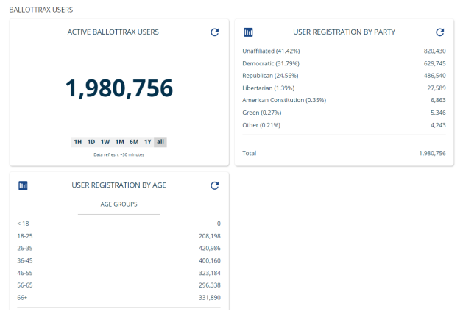
2022 Primary BallotTrax Statistics

Slide 12
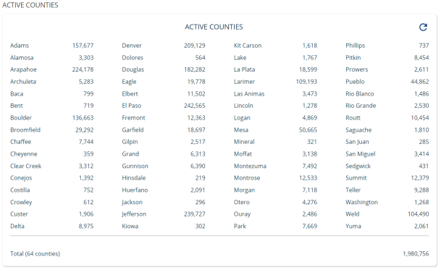
2022 Primary BallotTrax by County

Slide 13
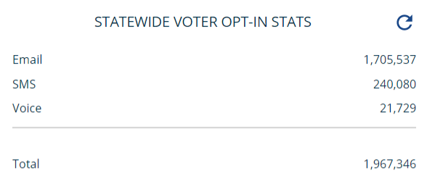
2022 Primary Election BallotTrax Usage By Method

Slide 14
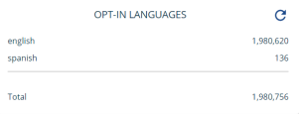
2022 Primary Election BallotTrax Usage By Language

Slide 15
2022 Primary Election BallotTrax Facts
BallotTrax users by county
Varies from a low of 25% in Sedgwick County to a high of 68.5% in Douglas County.
BallotTrax usage by age group
46-55 age group represents 17.49% of registered voters, but 20.20% of BallotTrax
36-45 age group represent 19.05% of registered voters, but 21.25% of BallotTrax
66+ age group represents 21.16% of registered voters, but 16.75% of BallotTrax

Slide 16
Questions?

